Slide 1
Greenplum Workshop
GPText - In Database Text Search and Analytics

Slide 2
What is GPText?
Joins GPDB with Apache Solr enterprise search and MADlib Analytics Library to support large scale text analytics processing
Supports free-text search and text analysis
Supports semi-structured and unstructured data
Uses statistical Machine Learning via MADlib for clustering, sentiment analysis, …

Slide 3
Why GPText
GPText enables processing mass quantities of raw text data (such as social media feeds or e-mail databases) into mission-critical information that guides project and business decisions.
Some potential uses are:
sentiment analysis
forensic analysis (financial, insurance, compliance, security)

Slide 4
Introduction
Why can't we simply use an index for full-text search?
Consider the phrase ‘GPDB is an MPP database management system’
Tokenize - split into array of words:
[‘GPDB’, ‘is’, ‘an’, ‘MPP’, ‘database’, ‘management’, ‘system’]::text[]
Move to lowercase:
[‘gpdb’, ‘is’, ‘an’, ‘mpp’, ‘database’, ‘management’, ‘system’]::text[]
Stem using Porter stemming:
[‘gpdb’, ‘is’, ‘an’, ‘mpp’, ‘databas’, ‘manag’, ‘system’]::text[]
Build binary index

Slide 5



GPText architecture
Scalable
One dedicated Solr instance per segment
“MPP Text” – can linearly scale
High Availability
Replicated
Standby Solr instance per segment
Database management features
Backup/restore
Online expansion
Data recovery
Performance monitoring
Full Text Search
Flexible indexing and search (stemming, phonetic search, multilingual search)
Join structured & text in one query
SQL
GPText
Master
Standby
Segment
Segment
Segment
…
Segment

Slide 6


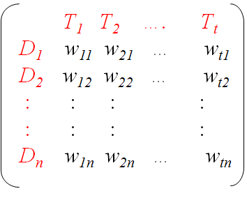
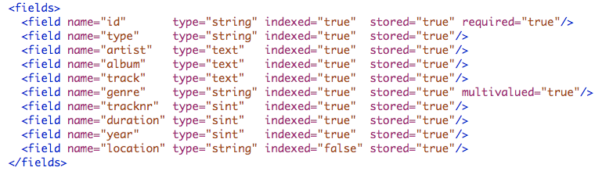
GPText capabilities
Index creation
Create, load, commit an index
Real data schema
Numeric types, dates, text
Define custom analyzer chains for different fields
Provides advanced full text search (FTS) capabilities
Faceted search and filtering
Lucene (default), complex, and surround query parsers
Vector space representation of document
Text analytics via Madlib
Master
Standby
Segment
Segment
Segment
Segment
Term-document matrix
Each w_{tn} is a list containing the positions of term T_{t} in document D_{n}
Notes:
Why do we need an index? What does it help with? – searches and queries are faster
Niels notes:
- strengths of gptext are: custom text analyzer chains, search, vector space representation of documents

Slide 7
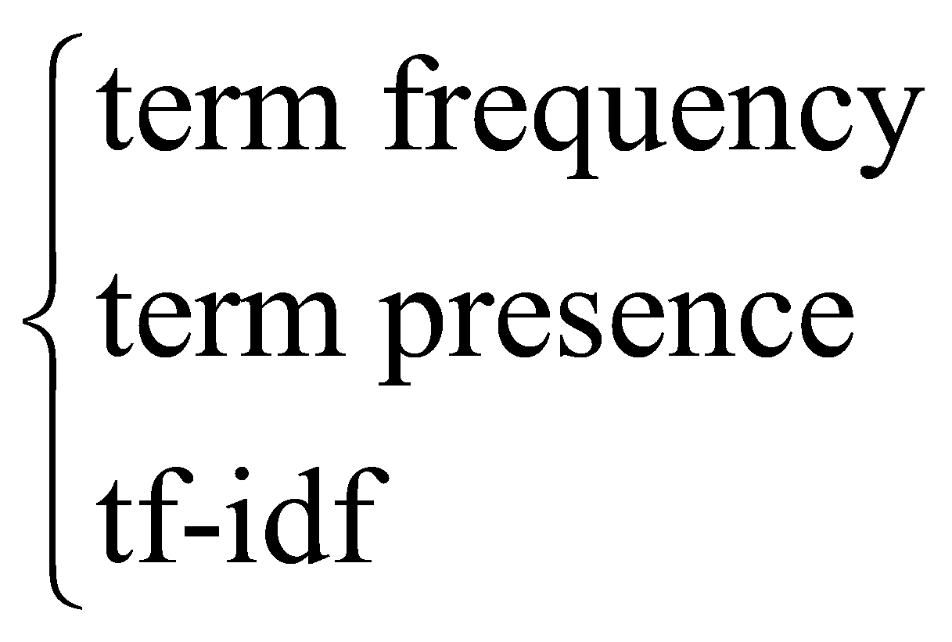
Text Analytics Workflow
SQL
GPText
MADlib
Create & set up GPText Index
Clustering
Create term table & dictionary table
Create 3 metrics for models
Topic Modeling
Classifier
Calculate Senti-Score
Regression
Notes:
Data transformation is part of the GPText workflow – before creating the term tables
Document frequecny tf-idf for each doc can be used to illuminate how and what MADlib functions are invoked
Sparce matrices create
Indexer – where does the analyzer come into this workflow
Tokenizer – part of GPText and explain – a parsing algorithm or set of rules
Analyzer – part of Gptext and explain –a set tokenizer of rules/algorithms collected together
Fix slide to have more boxes that include the data transform, the tokenizers, and the analyzers

Slide 8
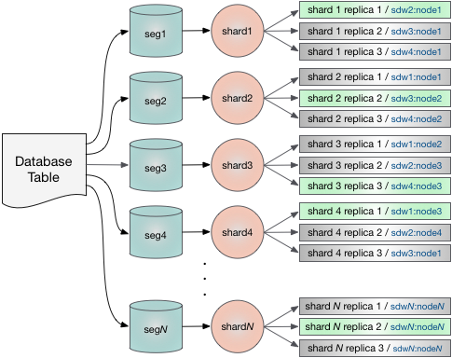
General Architecture - GPText 3.0

Slide 9
General Architecture
GPText consists of
Database functions in gptext schema
Some functions are in pl/pgsql for simplicity
Main interface functions are in C
Shared library “gptext-2.0.0.so”
Contains Postgres C functions
Uses libcurl.so to query REST API of the Solr
Uses libxml2.so to parse XML response from Solr REST API
SolrCloud
Zookeeper instances manage and monitor SolrCloud cluster
Solr and Lucene core jar libraries

Slide 10
Main Functions
Index functions
create index, index, drop index, commit index, etc.
Search functions
search, faceted search, etc.
Terms operations
enable terms for index, create terms table for specific query, document vector creation, etc.
General functions
Index statistics, gptext status, gptext version, etc.

Slide 11
Main Functions
Create Index
Metadata operation in Solr, simple REST API call
Index Data
Function executes on the segment level
Function accepts stream of table tuples and passes them to the Solr instance
Solr performs analysis of passed in text and adds them to the index
Commit Index
Metadata operation in Solr, simple REST API call

Slide 12
Main Functions
Search
Simple REST API call performed by each of the segments
Each of the segments returns data separately and does not know about results returned by other segments
Drop index
Metadata operation in Solr that causes index files to drop, simple REST API call

Slide 13
Examples - Setup
create schema test; -- assumes gptext schema in template1
create table test.test_data (id bigint, data varchar);
insert into test.test_data (id, data) values
(1, 'example text #1, not much information'),
(2, 'example text #2, a bit more information, but still not enough'),
(3, 'A.Grishchenko is reading this course'),
(4, 'Verint team is participating'),
(5, 'This course is really intensive'),
(6, 'Design of the distributed systems is really important'),
(7, 'The information you get here should be valuable');
select gptext.create_index ('test', 'test_data', 'id', 'data');
select * from gptext.index(TABLE(select * FROM test.test_data), 'test.test.test_data');
select * from gptext.commit_index('test.test.test_data');
Notes:
create schema test;create table test.test_data (id bigint, data varchar);insert into test.test_data (id, data) values(1, 'example text #1, not much information'),(2, 'example text #2, a bit more information, but still not enough'),(3, 'A.Grishchenko is reading this course'),(4, 'Verint team is participating'),(5, 'This course is really intensive'),(6, 'Design of the distributed systems is really important'),(7, 'The information you get here should be valuable');select gptext.create_index ('test', 'test_data', 'id', 'data');select * from gptext.index(TABLE(select * FROM test.test_data), 'test.test.test_data');select * from gptext.commit_index('test.test.test_data');select t.id, t.score, t2.data from gptext.search(TABLE(SELECT 1 SCATTER BY 1), 'test.test.test_data', 'example', null, null) as t, test.test_data as t2where t.id = t2.id;
select t.id, t.score, t2.data
from gptext.search(TABLE(SELECT 1 SCATTER BY 1), 'test.test.test_data', 'valuable information', null, null) as t,
test.test_data as t2
where t.id = t2.id;
select t.id, t.score, t2.data
from gptext.search(TABLE(SELECT 1 SCATTER BY 1), 'test.test.test_data', 'course information', null, null) as t,
test.test_data as t2
where t.id = t2.id;

Slide 14
Examples - Search 1
test=# select t.id, t.score, t2.data
test-# from gptext.search(TABLE(SELECT 1 SCATTER BY 1),
test-# 'testdb.test.test_data', 'example', null, null) as t,
test-# testdb.test_data as t2
test-# where t.id = t2.id;
id | score | data
----+--------+--------------------------------------------------------------
1 | 0.7407 | example text #1, not much information
2 | 0.4392 | example text #2, a bit more information, but still not enough
Notes:
create schema test;create table test.test_data (id bigint, data varchar);insert into test.test_data (id, data) values(1, 'example text #1, not much information'),(2, 'example text #2, a bit more information, but still not enough'),(3, 'A.Grishchenko is reading this course'),(4, 'Verint team is participating'),(5, 'This course is really intensive'),(6, 'Design of the distributed systems is really important'),(7, 'The information you get here should be valuable');select gptext.create_index ('test', 'test_data', 'id', 'data');select * from gptext.index(TABLE(select * FROM test.test_data), 'test.test.test_data');select * from gptext.commit_index('test.test.test_data');select t.id, t.score, t2.data from gptext.search(TABLE(SELECT 1 SCATTER BY 1), 'test.test.test_data', 'example', null, null) as t, test.test_data as t2where t.id = t2.id;
select t.id, t.score, t2.data
from gptext.search(TABLE(SELECT 1 SCATTER BY 1), 'test.test.test_data', 'valuable information', null, null) as t,
test.test_data as t2
where t.id = t2.id;
select t.id, t.score, t2.data
from gptext.search(TABLE(SELECT 1 SCATTER BY 1), 'test.test.test_data', 'course information', null, null) as t,
test.test_data as t2
where t.id = t2.id;

Slide 15
Examples - Search 2
test=# select t.id, t.score, t2.data
test-# from gptext.search(TABLE(SELECT 1 SCATTER BY 1),
test-# 'testdb.test.test_data', 'valuable information', null, null) as t,
test-# testdb.test_data as t2
test-# where t.id = t2.id;
id | score | data
----+--------+--------------------------------------------------------------
2 | 0.1221 | example text #2, a bit more information, but still not enough
1 | 0.1705 | example text #1, not much information
7 | 0.7976 | The information you get here should be valuable
Notes:
create schema test;create table test.test_data (id bigint, data varchar);insert into test.test_data (id, data) values(1, 'example text #1, not much information'),(2, 'example text #2, a bit more information, but still not enough'),(3, 'A.Grishchenko is reading this course'),(4, 'Verint team is participating'),(5, 'This course is really intensive'),(6, 'Design of the distributed systems is really important'),(7, 'The information you get here should be valuable');select gptext.create_index ('test', 'test_data', 'id', 'data');select * from gptext.index(TABLE(select * FROM test.test_data), 'test.test.test_data');select * from gptext.commit_index('test.test.test_data');select t.id, t.score, t2.data from gptext.search(TABLE(SELECT 1 SCATTER BY 1), 'test.test.test_data', 'example', null, null) as t, test.test_data as t2where t.id = t2.id;
select t.id, t.score, t2.data
from gptext.search(TABLE(SELECT 1 SCATTER BY 1), 'test.test.test_data', 'valuable information', null, null) as t,
test.test_data as t2
where t.id = t2.id;
select t.id, t.score, t2.data
from gptext.search(TABLE(SELECT 1 SCATTER BY 1), 'test.test.test_data', 'course information', null, null) as t,
test.test_data as t2
where t.id = t2.id;

Slide 16
Examples - Search 3
test=# select t.id, t.score, t2.data
test-# from gptext.search(TABLE(SELECT 1 SCATTER BY 1),
test-# 'testdb.test.test_data', 'course information', null, null) as t,
test-# testdb.test_data as t2
test-# where t.id = t2.id;
id | score | data
----+--------+--------------------------------------------------------------
1 | 0.1991 | example text #1, not much information
3 | 0.2276 | A.Grishchenko is reading this course
5 | 0.2276 | This course is really intensive
7 | 0.1707 | The information you get here should be valuable
2 | 0.1221 | example text #2, a bit more information, but still not enough
Notes:
create schema test;create table test.test_data (id bigint, data varchar);insert into test.test_data (id, data) values(1, 'example text #1, not much information'),(2, 'example text #2, a bit more information, but still not enough'),(3, 'A.Grishchenko is reading this course'),(4, 'Verint team is participating'),(5, 'This course is really intensive'),(6, 'Design of the distributed systems is really important'),(7, 'The information you get here should be valuable');select gptext.create_index ('test', 'test_data', 'id', 'data');select * from gptext.index(TABLE(select * FROM test.test_data), 'test.test.test_data');select * from gptext.commit_index('test.test.test_data');select t.id, t.score, t2.data from gptext.search(TABLE(SELECT 1 SCATTER BY 1), 'test.test.test_data', 'example', null, null) as t, test.test_data as t2where t.id = t2.id;
select t.id, t.score, t2.data
from gptext.search(TABLE(SELECT 1 SCATTER BY 1), 'test.test.test_data', 'valuable information', null, null) as t,
test.test_data as t2
where t.id = t2.id;
select t.id, t.score, t2.data
from gptext.search(TABLE(SELECT 1 SCATTER BY 1), 'test.test.test_data', 'course information', null, null) as t,
test.test_data as t2
where t.id = t2.id;

Slide 17
Solr Introduction

Slide 18
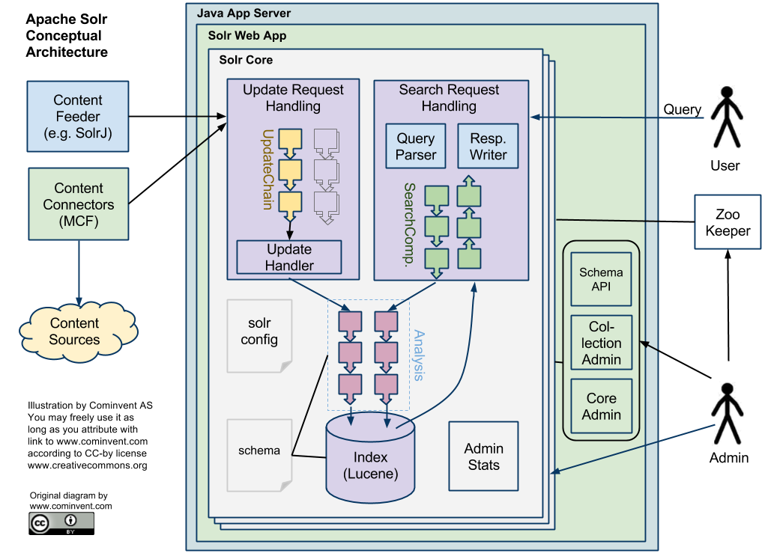
Conceptual Architecture

Slide 19
Conceptual Architecture
Solr consists of
Jetty Servlet Container
Solr Web Application
Solr Core Libraries
Lucene Indexing Core
Jetty Servlet Container
Basically is HTTP server for Java applications
Hosts Solr web application “solr.war”

Slide 20
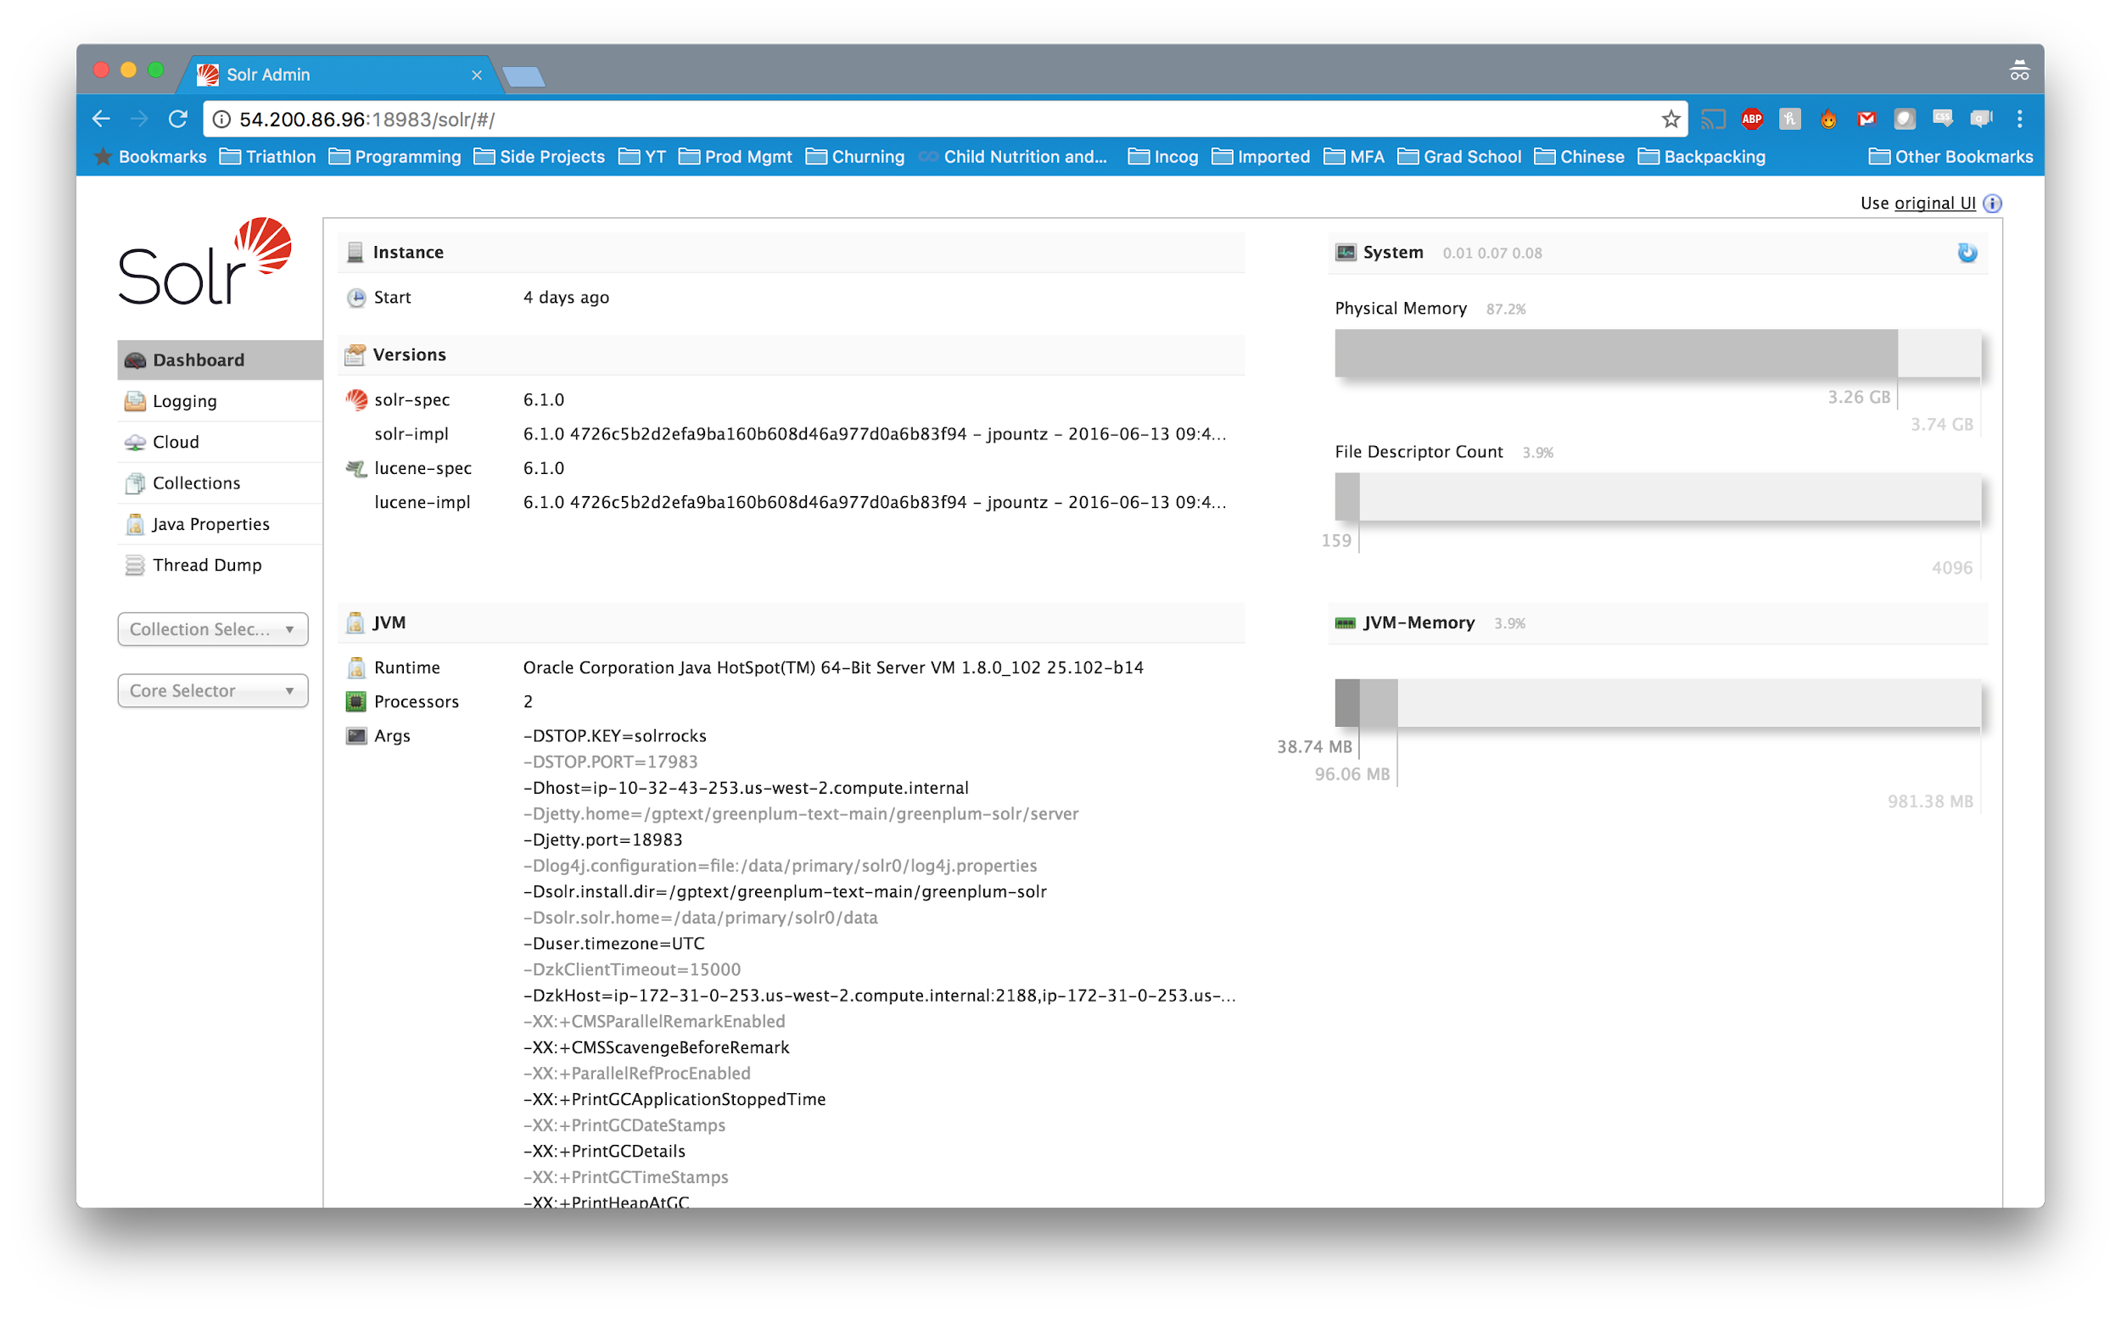
Conceptual Architecture
Solr Web Application
Provides WebUI for system status and performance monitoring
Notes:
Port 18983

Slide 21
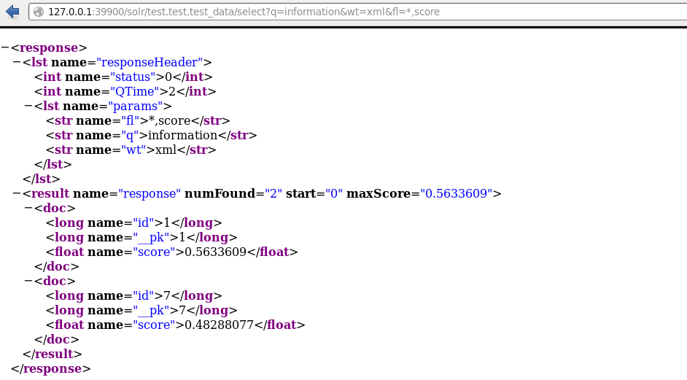
Conceptual Architecture
Solr Web Application
Provides REST API for applications (querying, data loading, maintenance, etc.)

Slide 22
Conceptual Architecture
Solr Core Libraries
Handling multiple independent indexes
Allowing specification of data/query processing chains using schema.xml/managed-schema
Providing replication capabilities
Tokenizers, Analyzers, Filters
Lucene Indexing Core
Index storage, caching
Transactional updates of the index
Querying the index, ranking the results

Slide 23
Differences?

Slide 24
GPText vs. Solr
Distributed Solr - Highly scalable
Leverages GPDB MPP architecture to distribute nodes and shards across multiple hosts
SQL Interface
All Solr calls and functionality are exposed through SQL UDFs for a consistent interface through psql/pgadmin/etc
Ease of Configurability
GUC Configuration management
gptext-config
Integrated with GPDB and included in PDS (Pivotal Data Suite)!

Slide 25
GPText vs. Solr (cont.)
International/Social Media Analyzer Chains
Additional Analyzer Chains with custom Tokenizers/Filters to be able to accurately parse out International Text (including CJK characters) and Social Media (hashtags, emoticons, links, etc.)
Unified Query Parser
Combines Solr and Lucene Query parsers into a single unified interface
Enables term vector support for text analytics with MADLib
LDA, K-Means Clustering, SVM

Slide 26
Searching with GPText

Slide 27
Anatomy of a Search Query
SELECT * FROM gptext.search(
TABLE( SELECT 1 SCATTER BY 1),
idx_name,
search_query,
filter_queries,
options
);
Searches text index for <search_query> and returns id’s and relevance scores of matching documents
idx_name - The name of the index to search.
search_query - Use enhanced Solr/Lucene query parser syntax
filter_queries - Array to filter out search terms by other columns in the index.
options - Solr options to limit data, order, highlight, or return full results.

Slide 28
Search Query
Basic lucene query syntax:
Term Match | "test" or "hello"
Field Specification | title:"The Right Way" AND text:"some text"
Wildcard Searches | te?t OR test*
Fuzzy Searches (Levenshtein Distance) | roam~ OR roam~0.8
Proximity Searches | "jakarta apache"~10
Range Searches | id:[5 TO 10] OR title"{Aida TO Carmen}
Term Boosting | jakarta^4 apache
Boolean Searching | AND, OR, NOT, +, -, etc
Grouping | (jakarta OR apache) AND website

Slide 29
Search Query
Enhanced solr query syntax:
Wild cards may be used in ranges | field:[* TO 100]
Pure negative queries | -inStock:false
Nested query parser support | _query_:"{!dismax}how now brown cow"

Slide 30
Search Query
Greenplum Unified Query Parser:
Combines functionality from common community query parsers
Ordered Proximity Searches | 5n(dog cat) OR 5w(cat dog)
Nested Proximity Searches | 5n(dog AND 3n(cat mouse) )
Wildcards in Phrases | "how now * brown cow"

Slide 31
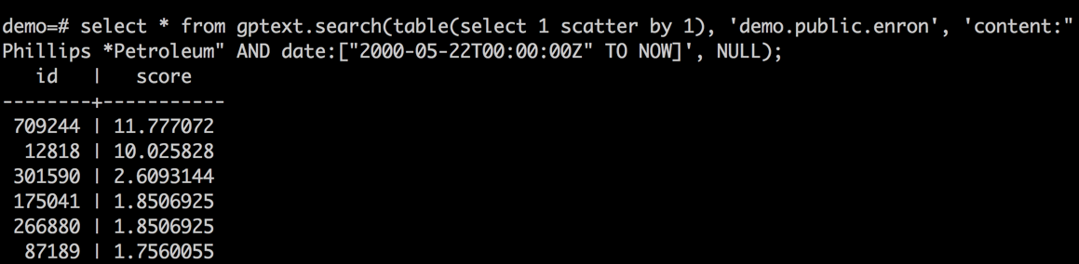
Search Query - Example
Search for email which contains ‘Phillips Petroleum’ after May 22nd,
Returns both document id and score. Higher score is, more relevant document is.

Slide 32
Search Query with Filter Query
SELECT * FROM gptext.search(
TABLE( SELECT 1 SCATTER BY 1),
idx_name,
search_query,
filter_queries,
options
);
Use filter queries to speed up search by filter cache.
gptext-config -i <index_name> -f solrconfig.xml to choose your own filter cache in <filterCache> section of solrconfig.xml
Put often occuring parts in search_query to filter_queries.

Slide 33
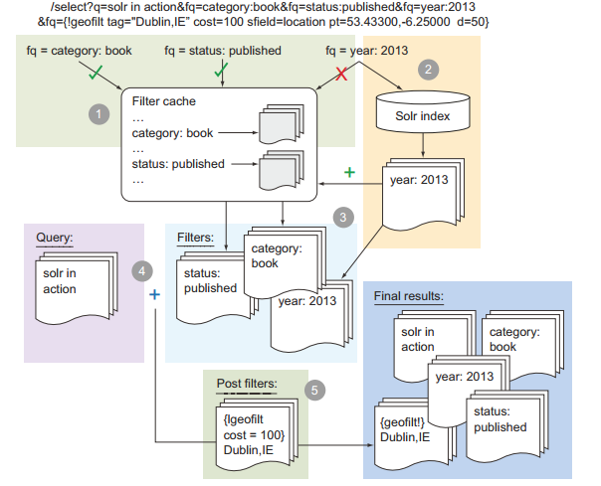
Search Query with Filter Query

Slide 34
Search Query with Filter Query
Search for email including ‘Phillips Petroleum’ in year 2000.
SELECT * FROM gptext.search(
TABLE( SELECT 1 SCATTER BY 1),
'demo.public.enron',
'content:"Phillips Petroleum"',
array['date:["2000-01-01T00:00:00Z" TO "2001-01-01T00:00:00Z"]'],
options
);

Slide 35
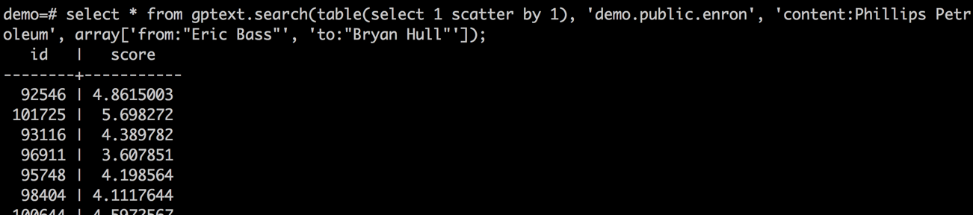
Search Query with Filter Query - Multi Filters
Search query with multiple filters
Search ‘Phillips Petroleum’ related emails sent from ‘Eric Bass’ and to ‘Bryan Hull’

Slide 36
Search Query with Options
SELECT * FROM gptext.search(
TABLE( SELECT 1 SCATTER BY 1),
idx_name,
search_query,
filter_queries,
options
);
Many solr options you could set in options separated by ‘&’
rows controls how many records returned for each segment
hl and hl.fl controls highlighting related search
fl returns extra fields including id and score
...

Slide 37
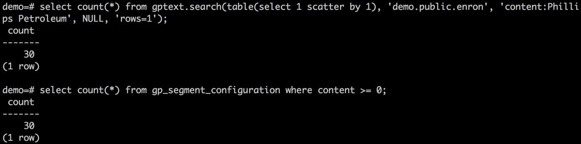
Search Query with Solr Limit
Returns only 1 row for each shard (segment)
i.e., 30 segments returns 30 records

Slide 38
Search Query
Joining results with original table
SELECT t.id t.content, q.score
FROM
mytable t,
SELECT * FROM gptext.search(
TABLE( SELECT 1 SCATTER BY 1),
myschema.mytable,
"cat AND dog",
NULL,
NULL
) q
WHERE t.id = q.id
);
Allows you to return more than just id and relevancy score
Query can have arbitrary complexity - join with additional tables or functions

Slide 39
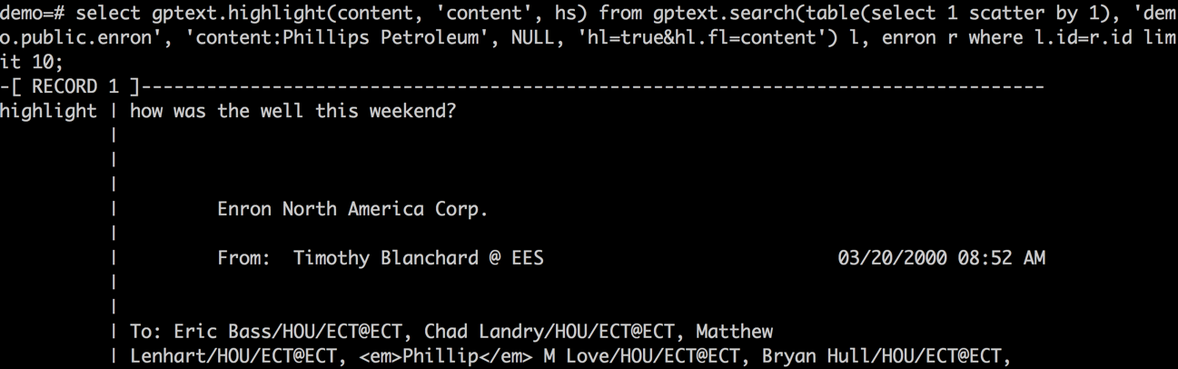
Search Query with Highlighting
Enable highlighting:
select gptext.enable_terms(<index_name>, <field_name>)
Join with original table to get highlight rendering.
Change highlight tag by GUC gptext.pre_hl_tag and gptext.post_hl_tag

Slide 40
Search Query with Returning Full Fields
SELECT *
FROM gptext.search(
TABLE( SELECT 1 SCATTER BY 1),
idx_name,
search_query,
filter_queries,
'fl=...'
);
Extra fields could be returned by fl option
gptext-config -i <index_name> -f managed-schema to change store as True
The result is buffer format, which looks like repeated: column_value { name: ‘<field_name>’ value: ‘<field_value>’ }
Use gptext_retrieve_field, gptext_retrieve_field_int8, gptext_retrieve_field_float8 to retrieve values.

Slide 41
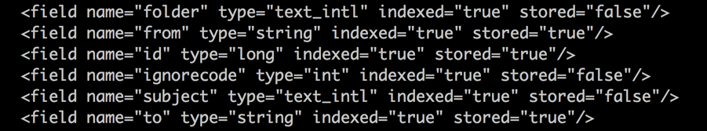
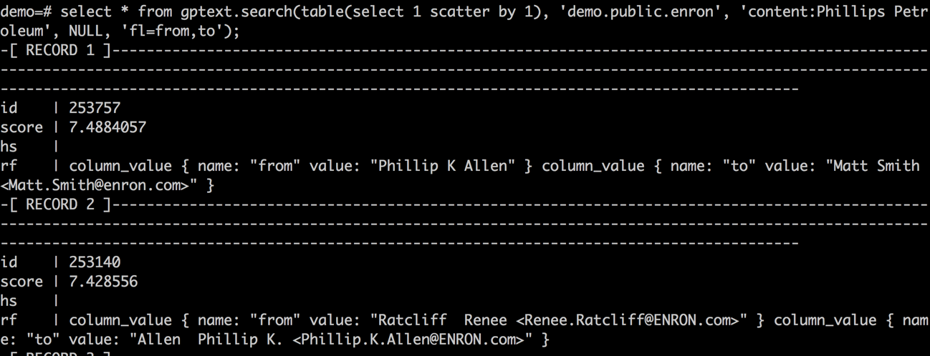
Search Query with Returning Full Fields

Slide 42
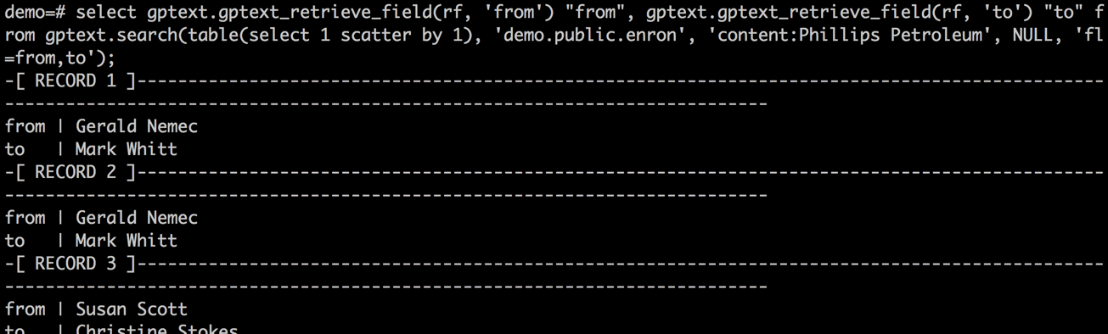
Using gptext.gptext_retrieve_field
Use gptext_retrieve_field to fetch text value of returned fields.
gptext_retrieve_field_int8 and gptext_retrieve_field_float8

Slide 43
STOP HERE
Stop here

Slide 44
Search engine index
Stores data to enable fast and accurate information retrieval
Useful to search large volumes of documents and retrieve relevant ones based on request
Google and Bing have indexes of the web
Indexing breaks up each document so that we know what word appears where in which document
id | creation_date | author | content
1 | 2012-02-15 | John Smith | What a great ….
2 | 2013-12-31 | Jane Doe | Please send the invoice asap…
.. | … | … | …
1000000 | 2012-06-20 | Frank Harris | When are the orders coming in…
Example:
Index the articles in the table
Provide full text search over the ‘content’ column
Question: Which document contains the word ‘send’?
Answer: Document with id = 2

Slide 45
Creating an index
Load table to be indexed into database
In practice, the table to be indexed can contain many more columns
CREATE TABLE articles
(
id bigint,
creation_date date,
author text,
content text,
)
distributed by (id);
id | creation_date | author | content
1 | 2012-02-15 | John Smith | What a great ….
2 | 2013-12-31 | Jane Doe | Please send the invoice asap…
.. | … | … | …
1000000 | 2012-06-20 | Frank Harris | When are the orders coming in…

Slide 46
Creating an empty index
To create an empty GPText index
Example:
This creates an index named <database_name>.<schema_name>.<table_name> on each segment
SELECT * FROM gptext.create_index(
schema_name, -- the schema of the table
table_name, -- the name of the table
id_col_name, -- the unique ID in the table
default_search_col)-– the default column to index
SELECT * FROM gptext.create_index(
‘public’, ‘articles’, ‘id’, ‘content’);

Slide 47
Enable terms
Enabling terms provides access to document level statistics of term occurrences
SELECT * FROM gptext.create_index(
‘public’, ‘articles’, ‘id’, ‘content’);
SELECT * FROM gptext.enable_terms(
‘database.public.articles’,
‘content’);
SELECT * FROM gptext.index(
TABLE(SELECT * FROM articles),
‘database.public.articles’);
SELECT * FROM gptext.commit_index(‘database.public.articles’);
Enable terms for a specified field after index creation or before re-indexing

Slide 48
Enable terms
Let’s enable the terms capability
-- 1.2 Enable terms table
-- gptext.terms(src_table, index_name, field_name, search_query, filter_queries, options)
-- remember to substitute your two digit student ID for the XX in the index name
select gptext.enable_terms('gptextdemo.twenty_news_groups','studentXX.gptextdemo.twenty_news_groups','contents');
Enable terms for the ‘content’ field after index creation or before re-indexing. For this example, there is no ‘search query’ , ‘filter queries’, or ‘options’

Slide 49
Populating an index
To populate an empty GPText index
Note:
Arguments to gptext.index() must be expressions
TABLE(SELECT * FROM table_name) creates a “table-valued expression” from the articles table, using the table function TABLE.
Selective index/updates by changing the inner select list in the query
Example:
SELECT * FROM gptext.index(
TABLE(SELECT * FROM table_name), -- table-valued expression
index_name) -- the name of the index
SELECT * FROM gptext.index(
TABLE(SELECT * FROM articles),
‘database.public.articles’);
Notes:
Instructor Notes:
The arguments to the gptext.index() function must be expressions.
TABLE(SELECT * FROM articles) creates a “table-valued expression” from the articles table, using the table function TABLE.
You can selectively index/update by changing the inner select list in the query.
Be careful about distribution policies:
The first parameter of gptext.index() is TABLE(SELECT * FROM articles). The query in this parameter should have the same distribution policy as the table you are indexing. However, there are two cases where the query will not have the same distribution policy:
Your query is a join of two tables
You are indexing an intermediate table (staging table) that is distributed
differently than the final table.
When the distribution policies differ, you must specify "SCATTER BY" for the query:
TABLE(SELECT * FROM articles SCATTER BY distrib_id), where distrib_id is the distribution id used when you created your primary/final table.

Slide 50
Committing an index
Make changes to an index persistent
To commit a populated GPText index
Note:
The index picks up any new data added since the last index commit when calling this function
Without committing, changes are not visible
Example:
SELECT * FROM gptext.commit_index(index_name) -- the name of the index
SELECT * FROM gptext.commit_index(
‘database.public.articles);

Slide 51
GPText index functions
Indexing
gptext.create_index()
gptext.enable_terms()
gptext.index()
gptext.commit_index()
Modifying or deleting an index
gptext.add_field()
gptext.delete()
gptext.drop_field()
gptext.drop_index()
gptext.rollback_index()
Configuration and monitoring
gptext.optimize_index()
gptext.reload_index()
gptext.index_statistics()

Slide 52
Searching a GPText index
Retrieve relevancy ranked documents from an index
Relevance score is determined by:
Term frequency – the frequency with which a term appears in a document
Inverse document frequency – the rarer a term is across all documents, the higher it’s contribution
Coordination factor – the more query terms are found in a document, the higher it’s score
Field length – penalizes longer documents
Boosts – assign more weight to specific terms
More details about scoring can be found in the SOLR documentation: https://wiki.apache.org/solr/SolrRelevancyFAQ
GPText uses the Unified Query Parser (QParserPlugin)
General purpose query parser with broad capabilities, but does not support span queries
GPText also supports: surround queries, complex phrase queries, and dismax queries (operator precedence)
Notes:
https://wiki.apache.org/solr/SolrRelevancyFAQ

Slide 53
Simple search query
SELECT c.id, c.author, c.content, q.score
FROM articles c,
gptext.search(
TABLE(SELECT * FROM articles),-- table-valued expression ‘database.public.articles’, -- the name of the index
‘invoice OR orders’, -- the query
null -- no filter options )q
where c.id = q.id;
Basic search term with boolean clauses
id | author | content | score
---------+-------------+---------------------------+-------
2 | Jane Doe |Please send the invoice... | 0.3256
100000 | Frank Harris|When are the orders ... | 0.2986
5937 | Hank Brown |Yesterday's invoice arr... | 0.2832
... | ... | ... | ...
Notes:
SOLR filter example:
If we had a language field we could search for only English articles
'{author_lang:en}', -- Solr filter

Slide 54
Surround query
SELECT c.id, c.author, q.score
FROM articles c,
gptext.search(
TABLE(SELECT 1 SCATTER BY 1), -- table-valued expression
‘database.public.articles’, -- the name of the index
‘mobi N web’, -- the query
null -- no filter options
‘defType=surround’ -- change the query parser
)q
where c.id = q.id;
N represents a distance. You can prefix it with a number (i.e. 2N, 3N) to increase the distance between words. This looks for the two words at most a particular distance from one another. If you use a W, then it means that the left word must precede the right word by W distance.
Notes:
Instructor Notes:
When executing GPText search queries, use TABLE(select 1 scatter by 1) as the table function to leverage the index scan.
The TABLE query is planned and affects the estimate of gptext.search(), but does not execute.
For example, if your query includes:
gptext.search(TABLE(SELECT * FROM t), ...)
The query planner estimates the number of results as the number of rows in t. This can cause the query planner to ignore the use of an index scan. Use a query like TABLE(SELECT 1 SCATTER BY 1) to avoid this issue.

Slide 55
Complex query
SELECT c.id, c.author, q.score
FROM articles c,
gptext.search(
TABLE(SELECT 1 SCATTER BY 1), -- table-valued expression
‘database.public.articles’, -- the name of the index
‘“mobi* web”’, -- the query
null, -- no filter options
‘defType=complex’ -- change the query parser
)q
where c.id = q.id;
This is a wild card search. Looks for any regex pattern matching mobi* and web (i.e. mobile web, mobility web)

Slide 56
More complex query examples
Boolean, wildcards, and distance queries
Substitute the following examples for the query in the gptext_search function
‘questions 5W answers 3W opinions’
‘(post 5N modernism) AND (evil 2W good)’
‘low W press*’
‘5n(temp*at*, (matt* OR (strike* 3n price*)))’
Notes:
Instructor Notes:
questions within 5 words before answers, and answers within 3 words before opinions. The use of the “W” instead of an “N” means that questions must come before answers and answers must come before opinions.
"Post" must be within 5 words of modernism (either before or after) and evil must be at most 2 words before good.
UQP Ordered search looking for low next to any word starting with press (i.e. pressure, press, pressing, etc.)
What do you think the last one is going to find?
mattress temperature?
Material template?
What else?
price strikeout template?

Slide 57
Faceted search queries
Faceting breaks up a search result into multiple categories and shows counts for each category.
Searches can be faceted as follows:
faceted_field_search() facets by field
faceted_query_search() facets by query
faceted_range_search() facets by range

Slide 58
Facets by field query
SELECT *
FROM gptext.faceted_field_search(
‘database.public.articles’, -- the name of the index
’*:*’, -- the query, *:* matches all
null, -- no filter options
’{author}’, -1, 5);
In this example, the query searches all articles in the data set by the authors field and retrieves only articles for authors who have created at least 5 articles.
field_name | field_value | value_count
------------+-------------+-------------
id | Frank Harris| 52
id | Hank Brown | 14
id | Jane Doe | 6
... | ... | ...

Slide 59
Highlighting search terms
gptext.highlight() highlights search terms by inserting markup tags before and after each occurrence of the term in results returned by gptext.search()
For example, if the search term is “iphone”, each occurrence of “iphone” in the data is marked up:
<em>iphone</em>
Useful when displaying search results on a webpage
SELECT c.id,
gptext.highlight(c.articles, ‘articles’, q.hs)
FROM articles c,
gptext.search(
TABLE(SELECT 1 SCATTER BY 1),-- table-valued expression index_name, -- the name of the index
’iphone’, -- the query
null -- no filter options
’hl=true&hl.fl=content’ -- SOLR options for highlighting )q
where c.id = q.id;
Notes:
Highlight function post processes highlight enabled search output -> adds overhead

Slide 60
Lab: Searching a GPText Index

Slide 61
Lab: Searching a GPText Index
Try a simple search query
-- 1.5 Performing a simple query
-- gptext.search(src_tbl, index_name, search_query, filter_queries, options)
-- remember to substitute your two digit student id for the XX in the index name
select * from gptext.search(TABLE(select * from gptextdemo.twenty_news_groups),
'studentXX.gptextdemo.twenty_news_groups',
'mac',
null
) limit 10;

Slide 62
GPText Tokenizers and Analyzers

Slide 63
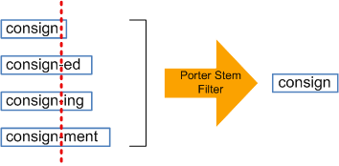
GPText analyzers – Getting ready for indexing
Normalize words (e.g., convert to lower case)
LOVE -> love
Analyze numbers and punctuations for relevancy
0-9, $#%@! ...
Remove stop words
you, me, we, us, in, on, to, here, there…
Stemming
Convert “running”, “runs” into “run”
In GPText
Notes:
Data transformation doesn’t have to remove words – for example, the Twitter Feed schema might addin extra data as useful nuggets – such as Emoticons, Hyperlinks, #hashtags, @users, etc
The twitter token filter doesn’t stem on emoticons, hyperlinks, #hashtags, @users, etc – it includes them as relevant data
GPText does this
These are things that “Can” be done to the data not things that have to be done.
Need to say why these are necessary - what do they accomplish. The reason is to get data consistency.
Niels notes:
- mention that these transformation are part of the solr analyzer chain and can be customized for your specific purposes. However, the default analyzer chain is a pretty good starting point for most text sources.
- Stemming does not turn “ran” into “run” (fixed on slide). Stemming solely tries to identify the stem of a word. The tool that would turn ran into run is lemmatization. This is not part of gptext.

Slide 64
Analyzer chains
An analyzer chain defines preprocessing sequences prior to indexing
Two main analyzer chains
text_intl – For use with international text
WorldLexer Improvements
text_sm – For use with social media (e.g., Twitter, Facebook)
Support for emoticons
Note: Search terms in queries are processed by the analyzer chain defined for an index
Document or query
Tokenizer
Stop word filter
Stemmer
GPText index
…
Notes:
If index is missing Stemming in analyzer chain, then query will also not be stemmed

Slide 65
Analyzer chain – text_intl
WLT – World lexer tokenizer
Separates CJK characters from others and identifies symbols
CJKWF – Chinese/Japanese/Korean word filter
Half/Full width characters
LCF – Lower case filter
WLBF – Word lexer bigram filter
Generates Bigrams for any CJK characters
Han, hiragana, katakana, hangul
SF – Stop word filter
KMF – Keyword marker filter
Marks words to prevent from being stemmed (protwords.txt)
PSF – Porter stemmer filter
Notes:
WLT – World Lexer Tokenizer
LCF – Lower Case Filter
WLBF – World Lexer Bigram Filter → Since particular languages operate in bigrams, it pairs text together in those languages.
SF – Stop Filter. Filters out stopwords (in the txt file)
KMF – Marks words that are in the protwords.txt file to prevent them from being stemmed.
PSF – Actually does the stemming.

Slide 66
Analyzer chain – text_sm
WT – Whitespace tokenizer
SF – Stop word filter
LCF – Lower case filter
ECTF – Emoticons classifier filter
Uses the emoticons.txt file
TTF – Twitter tokenizer
Extends whitespace tokenizer
Emoticons, hyperlinks, #hashtags, @users, etc.
Notes:
WT – Whitespace Tokenizer
ECTF – Classifies Emoticons into their particular category. Located in emoticons.txt config file.
TTF – Twitter Token Filter (aka Twitter Stem Filter). Only stems non-social media terms (i.e. NOT hashtags, links, emoticons, etc.)

Slide 67
Configuring GPText with gptext-config
Allows editing the index configuration files:
schema.xml
stopwords.txt
protwords.txt
synonyms.txt
elevate.xml
emoticons.txt
Distributes the specified configuration files to the specified directory. (-d parameter)
Allows distribution of jar files. (-j parameter)
Modifies jvm_options. (-o parameter)
Appends a file to one of the configuration files. (-a parameter)
Sets properties in the solr.xml configuration file (-k parameter)
Notes:
WT – Whitespace Tokenizer
ECTF – Classifies Emoticons into their particular category. Located in emoticons.txt config file.
TTF – Twitter Token Filter (aka Twitter Stem Filter). Only stems non-social media terms (i.e. NOT hashtags, links, emoticons, etc.)

Slide 68
Configuring analyzer chains with gptext-config
Edit the schema.xml with gptext-config:
Use command: gptext-config –f schema.xml –i <index_name> -e
Find the XML line corresponding to indexed column of the database table (e.g., content)
<field name=”<text_search_col>" indexed="true" stored="false" type="text_intl"/>
Gptext-config syntax:
gptext-config -f <file_name> -i <index_name> [-r] [-e] [-b]
gptext-config -d <path/file_name> -i <index_name>
gptext-config -j <path/jar_file>
gptext-config -o <jvm_options>
gptext-config -f <file_name> -i <index_name> -a <file_to_append>
gptext-config -k <solr_key> -s <solr_value>
Edit type to either “text_intl” or “text_sm”

Slide 69
3 metrics to enable Analytics

Slide 70
Text Analytics Workflow
SQL
GPText
MADlib
Create & set up GPText Index
Clustering
Create term table & dictionary table
Create 3 metrics for models
Topic Modeling
Classifier
Calculate Senti-Score
Regression
Notes:
Data transformation is part of the GPText workflow – before creating the term tables
Document frequecny tf-idf for each doc can be used to illuminate how and what MADlib functions are invoked
Sparce matrices create
Indexer – where does the analyzer come into this workflow
Tokenizer – part of GPText and explain – a parsing algorithm or set of rules
Analyzer – part of Gptext and explain –a set tokenizer of rules/algorithms collected together
Fix slide to have more boxes that include the data transform, the tokenizers, and the analyzers

Slide 71
Enable terms (repeat for context)
Enabling terms provides access to document level statistics of term occurrences
SELECT * FROM gptext.create_index(
‘public’, ‘articles’, ‘id’, ‘content’);
SELECT * FROM gptext.enable_terms(
‘database.public.articles’,
‘content’);
SELECT * FROM gptext.index(
TABLE(SELECT * FROM articles),
‘database.public.articles’);
SELECT * FROM gptext.commit_index(‘database.public.articles’);
Enable terms for a specified field after index creation or before re-indexing

Slide 72
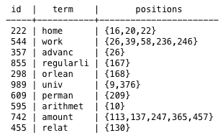
Creating a terms table in the database
CREATE TABLE terms_table AS
SELECT *
FROM gptext.terms(TABLE(SELECT 1 SCATTER BY 1),
‘database.public.articles’, -- the name of the index
‘content’, -- the field for which to extract
the terms (must have terms enabled)
’*’, -- a search query
null); -- no filter query
Example terms table
id … the unique id of a document
term … a term appearing in the document
positions … the token positions where the term appeared in the document

Slide 73
Data transformation – create corpus matrices
Term Frequency Matrix
The number of times term 13 appears in document 4
 | term1 | term2 | term3 | term4 | term5 | term6 | term7 | term8 | term9 | term10 | term11 | term12 | term13 | term14
Doc1 | 0 | 0 | 0 | 0 | 0 | 0 | 0 | 0 | 0 | 0 | 0 | 0 | 0 | 0
Doc2 | 1 | 0 | 0 | 0 | 0 | 0 | 0 | 0 | 0 | 0 | 0 | 0 | 0 | 1
Doc3 | 0 | 2 | 0 | 0 | 1 | 0 | 1 | 0 | 0 | 0 | 0 | 0 | 0 | 0
Doc4 | 0 | 0 | 1 | 0 | 0 | 0 | 0 | 0 | 0 | 3 | 5 | 0 | 2 | 0
Doc5 | 0 | 0 | 0 | 2 | 0 | 0 | 2 | 0 | 0 | 0 | 0 | 0 | 0 | 0
Doc6 | 0 | 0 | 3 | 0 | 0 | 0 | 0 | 0 | 4 | 0 | 0 | 0 | 0 | 0
Doc7 | 0 | 0 | 0 | 0 | 0 | 0 | 0 | 0 | 0 | 0 | 0 | 2 | 0 | 0
Doc8 | 0 | 0 | 0 | 0 | 0 | 0 | 0 | 0 | 0 | 0 | 0 | 0 | 0 | 0
Doc9 | 0 | 0 | 0 | 0 | 0 | 0 | 0 | 0 | 0 | 0 | 0 | 0 | 0 | 3
Doc10 | 0 | 0 | 0 | 0 | 0 | 0 | 0 | 0 | 0 | 0 | 0 | 0 | 0 | 0
Term Presence Matrix
 | term1 | term2 | term3 | term4 | term5 | term6 | term7 | term8 | term9 | term10 | term11 | term12 | term13 | term14
Doc1 | 0 | 0 | 0 | 0 | 0 | 0 | 0 | 0 | 0 | 0 | 0 | 0 | 0 | 0
Doc2 | 1 | 0 | 0 | 0 | 0 | 0 | 0 | 0 | 0 | 0 | 0 | 0 | 0 | 1
Doc3 | 0 | 1 | 0 | 0 | 1 | 0 | 1 | 0 | 0 | 0 | 0 | 0 | 0 | 0
Doc4 | 0 | 0 | 1 | 0 | 0 | 0 | 0 | 0 | 0 | 1 | 1 | 0 | 1 | 0
Doc5 | 0 | 0 | 0 | 1 | 0 | 0 | 1 | 0 | 0 | 0 | 0 | 0 | 0 | 0
Doc6 | 0 | 0 | 1 | 0 | 0 | 0 | 0 | 0 | 1 | 0 | 0 | 0 | 0 | 0
Doc7 | 0 | 0 | 0 | 0 | 0 | 0 | 0 | 0 | 0 | 0 | 0 | 1 | 0 | 0
Doc8 | 0 | 0 | 0 | 0 | 0 | 0 | 0 | 0 | 0 | 0 | 0 | 0 | 0 | 0
Doc9 | 0 | 0 | 0 | 0 | 0 | 0 | 0 | 0 | 0 | 0 | 0 | 0 | 0 | 1
Doc10 | 0 | 0 | 0 | 0 | 0 | 0 | 0 | 0 | 0 | 0 | 0 | 0 | 0 | 0
1: presence
0: absence
Notes:
Lead in to talk about sparse matrices -

Slide 74
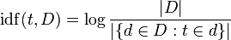
Data transformation – TF-IDF matrix
tf–idf = term frequency x inverse document frequency
 | term1 | term2 | term3 | term4 | term5 | term6 | term7 | term8 | term9 | term10 | term11 | term12 | term13 | term14
Doc1 | 0 | 0 | 0 | 0 | 0 | 0 | 0 | 0 | 0 | 0 | 0 | 0 | 0 | 0
Doc2 | 0.32 | 0 | 0 | 0 | 0 | 0 | 0 | 0 | 0 | 0 | 0 | 0 | 0 | 1
Doc3 | 0 | 0.53 | 0 | 0 | 0.21 | 0 | 0.24 | 0 | 0 | 0 | 0 | 0 | 0 | 0
Doc4 | 0 | 0 | 0.4 | 0 | 0 | 0 | 0 | 0 | 0 | 0.61 | 0.71 | 0 | 2.2 | 0
Doc5 | 0 | 0 | 0 | 3.43 | 0 | 0 | 0.32 | 0 | 0 | 0 | 0 | 0 | 0 | 0
Doc6 | 0 | 0 | 0.67 | 0 | 0 | 0 | 0 | 0 | 0.48 | 0 | 0 | 0 | 0 | 0
Doc7 | 0 | 0 | 0 | 0 | 0 | 0 | 0 | 0 | 0 | 0 | 0 | 1.1 | 0 | 0
Doc8 | 0 | 0 | 0 | 0 | 0 | 0 | 0 | 0 | 0 | 0 | 0 | 0 | 0 | 0
Doc9 | 0 | 0 | 0 | 0 | 0 | 0 | 0 | 0 | 0 | 0 | 0 | 0 | 0 | 0.21
Doc10 | 0 | 0 | 0 | 0 | 0 | 0 | 0 | 0 | 0 | 0 | 0 | 0 | 0 | 0
A high weight in tf–idf is reached by a high term frequency (in the given document) and a low document frequency of the term in the whole collection of documents
A numerical statistic which reflects how important a word is to a document in a collection or corpus
total number of documents
the number of documents containing the term
Notes:
Niels notes:
– mention that TF-IDF is typically used to discount words such as ‘and’, ‘the’ (or other stop words) because they appear in most documents. This helps in search applications where you want to retrieve documents with the highest relevance for a given term – i.e., get documents with high tf-idf for a given term.

Slide 75
Lab: 3 metrics

Slide 76
Lab: Creating the Terms table
Create the terms table
-- 1.6 Create Terms Table
-- remember to substitute your two digit student id for the XX in the index name
drop table if exists gptextdemo.twenty_news_groups_terms cascade;
create table gptextdemo.twenty_news_groups_terms as
(
select *
-- gptext.terms(src_table, index_name, field_name, search_query, filter_queries, options)
from gptext.terms(TABLE
(
select * from gptextdemo.twenty_news_groups),
'studentXX.gptextdemo.twenty_news_groups’,'contents’,'*:*’,null
)
) distributed by (id);
-- now we should show the table so we can see the result
select * from gptextdemo.twenty_news_groups_terms limit 2;

Slide 77
Lab: Creating the term dictionary
Create the term dictionary
-- 1.7 Create term dictionary
drop table if exists gptextdemo.twenty_news_groups_terms_dict cascade;
create table gptextdemo.twenty_news_groups_terms_dict as
(
select row_number() over(order by term asc) as idx,
term,
term_freq
from
( select term,
count (*) as term_freq
from gptextdemo.twenty_news_groups_terms
where term is not null
group by term
) q where term_freq > 50 -- disregard terms which occur less than 50 times at least (long tail).
) distributed by (idx);
select * from gptextdemo.twenty_news_groups_terms_dict limit 10;

Slide 78
Lab: Create the sparse vectors
Create a sparse vector with td-idf scores for the corpus
-- 1.8 Create sparse vectors representation using tf-idf scores for the corpus
drop table if exists gptextdemo.twenty_news_groups_corpus cascade;
create table gptextdemo.twenty_news_groups_corpus as (
select terms.id,
gptext.gen_float8_vec
-- gptext.gen_float8_vec(index_array, count_array, vector_size)
(
array_agg(dict.idx), -- Array of indices
array_agg(array_upper(terms.positions, 1)), -- Array of values at indices
-- gptext.count_t(table_name)
gptext.count_t('gptextdemo.twenty_news_groups_terms_dict') --# terms in dictionary
)::madlib.svec sfv
from gptextdemo.twenty_news_groups_terms terms, gptextdemo.twenty_news_groups_terms_dict dict
where terms.term = dict.term
group by terms.id
) distributed by (id);

Slide 79
Lab: Create the tf-idf feature vector
Create the tf-idf feature vector table
-- 1.9 TF-IDF feature vector
drop table if exists gptextdemo.twenty_news_groups_fvect_tfidf;
create table gptextdemo.twenty_news_groups_fvect_tfidf as
(select
id as doc_id,
madlib.svec_mult( sfv, logidf ) as tf_idf
from gptextdemo.twenty_news_groups_corpus,
(select madlib.svec_log
(madlib.svec_div
(count(sfv)::madlib.svec,
madlib.svec_count_nonzero(sfv)
)
) as logidf
from gptextdemo.twenty_news_groups_corpus
) foo
order by doc_id
) distributed by (doc_id);
\x
select * from gptextdemo.twenty_news_groups_fvect_tfidf limit 1;

Slide 80
NLP: Practical Examples

Slide 81
Common NLP tasks
NLP Task | Example
Sentence Segmentation Identify sentence boundaries | He said: “Hi! What’s up - Mr. President?”
Tokenization Identify word/token boundaries | My phone tries to change 'eating' to 'dating’. #ihateautocorrect
Part-of-Speech Tagging | If you build it , he will come . IN PRP VBP PRP , PRP MD VB .
Stemming / lemmatization | eating = eat / ate = eat
Parsing | (S (NP (NP John) and (NP Frank)) (VP went (PP into (NP a bar))))
Named Entity Recognition | Let’s meet John in DC at 6pm.
Co-reference resolution | John drank a beer. He thought It was warm.
Notes:
Instructor Notes:
Parsing: A natural language parser is a program that works out the grammatical structure of sentences, for instance, which groups of words go together (as "phrases") and which words are the subject or object of a verb. Probabilistic parsers use knowledge of language gained from hand-parsed sentences to try to produce the most likely analysis of new sentences. These statistical parsers still make some mistakes, but commonly work rather well. Their development was one of the biggest breakthroughs in natural language processing in the 1990s. You can try out our parser online.
http://nlp.stanford.edu/software/lex-parser.shtml
Named Entity Recognition: Named Entity Recognition (NER) labels sequences of words in a text which are the names of things. The Stanford NER comes with well-engineered feature extractors for Named Entity Recognition, and many options for defining feature extractors. Included with the download are good named entity recognizers for English, particularly for the 3 classes (PERSON, ORGANIZATION, LOCATION).
http://nlp.stanford.edu/software/CRF-NER.shtml
Co-reference resolution: Coreference resolution is the task of finding all expressions that refer to the same entity in a text. It is an important step for a lot of higher level NLP tasks that involve natural language understanding such as document summarization, question answering, and information extraction.
http://nlp.stanford.edu/projects/coref.shtml

Slide 82
Regular expressions (Regex)
What are regular expressions?
Wikipedia: “Provide means for matching strings of text”
CS lecture: Specify languages that are accepted by finite state machines
In NLP regex are often used to derive features
Word is all caps
First letter of word is lower/upper case
Token contains numbers and letters (e.g., biological entities SNP76325)
Token contains special characters
Examples:
Syntactically correct email addresses
Convert 9 digits into format “(123) 456-7890”

Slide 83
Regex in GPDB
Operators (~, ~*, and negated versions !~, !~*):
Operator | Description | Example
~ | case-sensitive substring | 'Greenplum' ~ '^Green'
~* | case-insensitive substring | 'Greenplum' ~ 'ee+'
Functions
substring(string [from pattern] [for escape])
regexp_matches(string, pattern, [flags])
regexp_replace(string, pattern, repl, [flags])
regexp_split_to_{array|table}
Regular expression functionality is also available via custom PL functions
Python module ‘re’
Java module ‘util.regex’

Slide 84
Regular expression syntax
Basic meta characters
See PostgreSQL website
Expression | Matches
. | Arbitrary character
^ and $ | Virtual characters for beginning and end
* | Preceding item zero or more times
+ | Preceding item one or more times
? | Preceding item is optional
{n} | Preceding item n times
a|b | Item a or b
… | …

Slide 85
N-grams
Often used in Markov models
Higher order n-grams preserve context in which words appear
Example:
“The quick brown fox jumped over the lazy dog.”
Unigram: | (The), (quick), (brown), ...
Bigram: | (The, quick), (quick, brown), (brown, fox), …
Trigram: | (The, quick, brown), (quick, brown, fox), (brown, fox, jumps), …
4-gram: | (The, quick, brown, fox), (quick, brown, fox, jumps), (brown, fox, jumps, over), …

Slide 86
PL/Python to extract n-grams
/* Extract n-grams from a text field */
CREATE OR REPLACE FUNCTION extract_ngrams(textfield text, min_n integer, max_n integer)
RETURNS text[] AS $BODY$
if textfield == None:
return None
tokens = textfield.split(" ") # tokenize by whitespace
list = []
n_tokens = len(tokens)
for i in xrange(n_tokens):
for j in xrange(i+min_n, min(n_tokens, i+max_n)+1):
list.append(' '.join(tokens[i:j]))
return list
$BODY$ LANGUAGE plpythonu IMMUTABLE;
Example:
SELECT extract_ngrams('The quick brown fox jumped over the lazy dog', 2, 2);
Result: {"The quick","quick brown","brown fox","fox jumped","jumped over","over the","the lazy","lazy dog"}

Slide 87




Utilizing NLP packages via PL languages
Languages
Python
R
Java
PGSQL
Extend database functions with open source packages
NLTK (Python)
TM (R)
OpenNLP (Java)
Many NLP tasks are embarrassingly parallel
PoS tagging
Parsing

Slide 88
Open source tools for common NLP tasks
RELEVANT NLP TOOLS
OPEN SOURCE SOFTWARE
Word Clouds
Tokenization
Stemming/lemmatization
GPText
Apache UIMA
OpenNLP (Java)
NLTK (Python)
WordNet
Pytagcloud
Stop word removal
Topic Modeling/Text Classification
Tokenization
Stemming/lemmatization
Madlib (PLDA)
gensim (LSA & LDA package for python)
https://code.google.com/p/language-detection/
Stop word removal
Language detection
Information Extraction
Tokenization
Sentence detection
Relationship extraction
GPText and Madlib
OpenNLP
NLTK
Stanford CoreNLP (incl. POS tagger, NER, parser, etc.)
Language detection
Syntactic parsing
Entity extraction

Slide 89
NLP: Practical examples with NLTK

Slide 90
Lemmatization using NLTK
Identify the lemma (citation form) of a word
Why:
Stemmers only stem
eating = eat (rule: remove ‘ing’)
They do not catch: ate = eat
Or better
Example:
ate = eats = eating → eat
good = better → good
Prerequisites
Access to WordNet dictionary files
/* Lemmatize, but only look for
* lemmas with the given Part-of-Speech */
CREATE OR REPLACE FUNCTION lemmatize(word text, pos text)
RETURNS text AS
$BODY$
import nltk
from nltk.stem.wordnet import WordNetLemmatizer
lemmatizer = WordNetLemmatizer()
return lemmatizer.lemmatize(word, pos)
$BODY$
LANGUAGE plpythonu;
Example:
SELECT lemmatize(’meeting’, ‘n’)
Result: ‘meeting’
SELECT lemmatize(’meeting’, ‘v’)
Result: ‘meet’

Slide 91
Part-of-Speech tagging
Assign each word with its part of speech, e.g., noun, adjective, verb, …
Can be used as features, to distinguish homonyms, or lemmatization
Example:
SELECT pos_tag(’We were meeting at the meeting.’, ‘n’)
Result: [('We', 'PRP'),
('were', 'VBD'),
('meeting', 'VBG'),
('at', 'IN'),
('the', 'DT'),
('meeting', 'NN'),
('.', '.')]
/**
* Part-of-speech tag the text in the textfield
*/
CREATE OR REPLACE FUNCTION pos_tag(textfield text)
RETURNS text[] AS
$BODY$
import nltk
tokens = nltk.word_tokenize(textfield)
return nltk.pos_tag(tokens)
$BODY$
LANGUAGE plpythonu;

Slide 92
Named entity recognition
Recognize entities in text and label them
LOCATION, ORGANIZATION, PERSON, DURATION, DATE, CARDINAL, PERCENT, MONEY, and MEASURE
/**
* Recognize NEs in the given textfield
*/
CREATE OR REPLACE FUNCTION ner(textfield text)
RETURNS text AS
$BODY$
import nltk
tokens = nltk.word_tokenize(textfield)
pos_tags = nltk.pos_tag(tokens)
return nltk.ne_chuck(pos_tags)
$BODY$
LANGUAGE plpythonu;
Example:
SELECT ner(’ John will arrive in New York at 9pm.’)
Result: Tree('S', [Tree('PERSON', [('John', 'NNP')]), ('will', 'MD'), ('arrive', 'VB'), ('in', 'IN'), Tree('GPE', [('New', 'NNP'), ('York', 'NNP')]), ('at', 'IN'), ('9pm', 'CD'), ('.', '.')])

Slide 93
Putting it all together

Slide 94
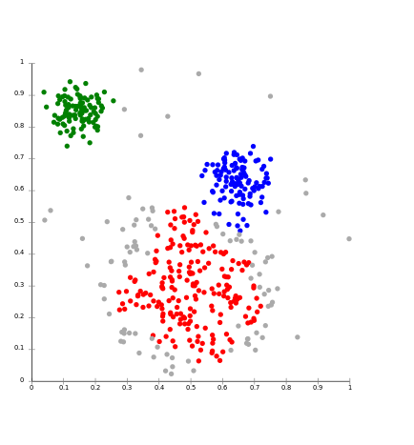

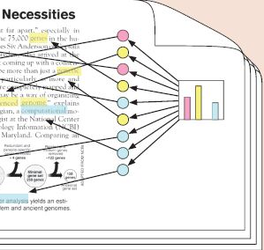
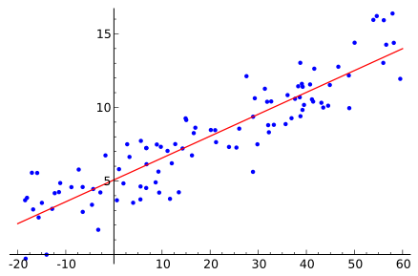

What’s possible with text analytics in GPDB
Document clustering
Topic modeling
Document classification
Sentiment analysis
Text regression
And much more …
Sports
News
Econ

Slide 95
GPText integration with MADlib
SQL
Vector space representation of documents in GPText lends itself to machine learning analysis with MADlib
Algorithms in MADlib operating on vectors
Support vector machines
Kmeans clustering
Conditional random fields
Parallel latent dirichlet allocation
Supporting data types in MADlib
Sparse vectors – are useful in representing word level features
GPText
MADlib
Create & set up GPText Index
Clustering
Create term table & dictionary table
Create 3 metrics for models
Topic Modeling
Classifier
Calculate Senti-Score
Regression
Notes:
Data transformation is part of the GPText workflow – before creating the term tables
Document frequecny tf-idf for each doc can be used to illuminate how and what MADlib functions are invoked
Sparce matrices create
Indexer – where does the analyzer come into this workflow
Tokenizer – part of GPText and explain – a parsing algorithm or set of rules
Analyzer – part of Gptext and explain –a set tokenizer of rules/algorithms collected together
Fix slide to have more boxes that include the data transform, the tokenizers, and the analyzers

Slide 96
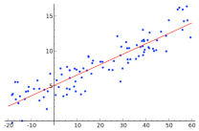
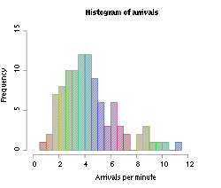
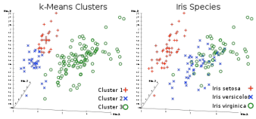
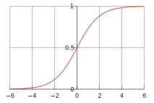
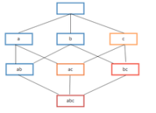
MADlib In-Database Functions
Predictive Modeling Library
Descriptive Statistics
Sketch-based Estimators
CountMin (Cormode-Muthukrishnan)
FM (Flajolet-Martin)
MFV (Most Frequent Values)
Correlation
Summary
Generalized Linear Models
Linear Regression
Logistic Regression
Multinomial Logistic Regression
Cox Proportional Hazards
Regression
Elastic Net Regularization
Sandwich Estimators (Huber white, clustered, marginal effects)
Machine Learning Algorithms
Principal Component Analysis (PCA)
Association Rules (Affinity Analysis, Market Basket)
Topic Modeling (Parallel LDA)
Decision Trees
Ensemble Learners (Random Forests)
Support Vector Machines
Conditional Random Field (CRF)
Clustering (K-means)
Cross Validation
Support Modules
Array Operations
Sparse Vectors
Random Sampling
Probability Functions
Matrix Factorization
Single Value Decomposition (SVD)
Low-Rank
Linear Systems
Sparse and Dense Solvers

Slide 97

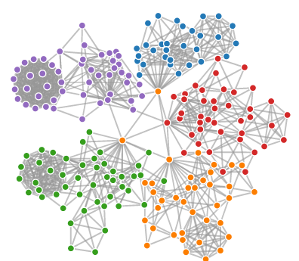
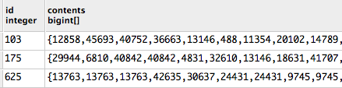
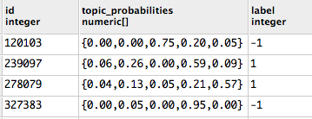
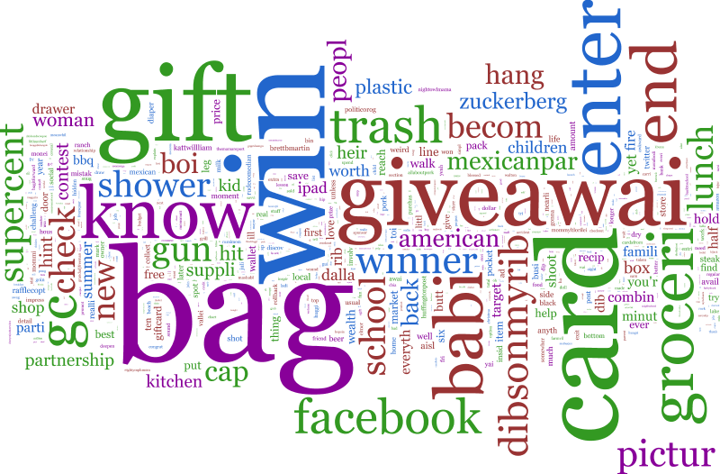
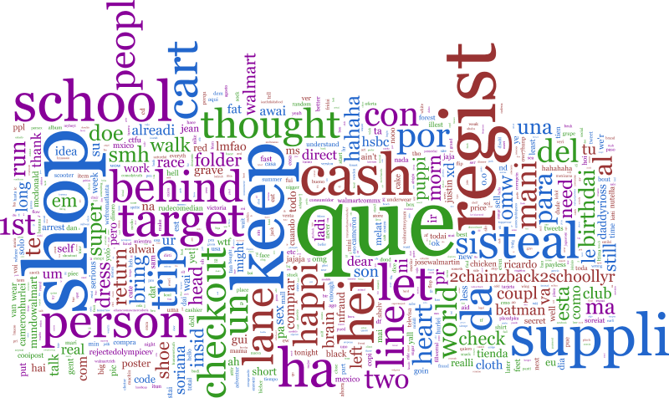
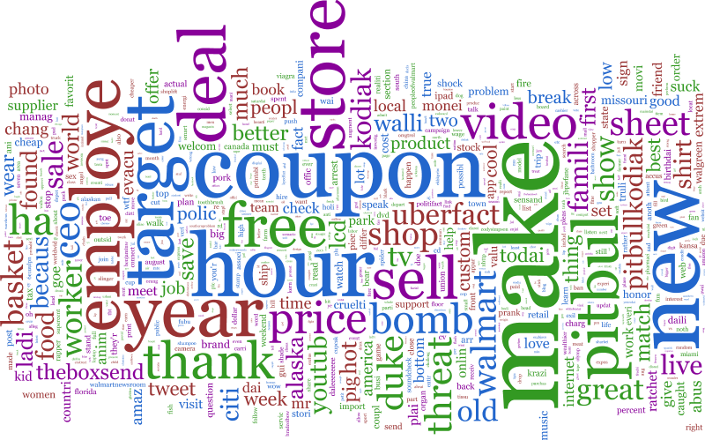
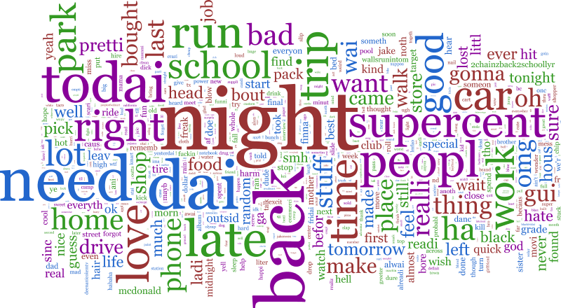
Topic analysis – MADlib pLDA
Natural Language Processing - GPText
Filter relevant content
Align Data
Social Media Tokenizer
Stemming, frequency filtering
Prepare dataset for Topic Modeling
Topic Graph
Topic composition
MADlib Topic Model
Topic Clouds
Notes:
1)GPText is just a wrapper on top of Apache SOLR. So users can use Apache SOLR (http://lucene.apache.org/solr/) to accomplish most of this without having to use a SQL based engine.

Slide 98
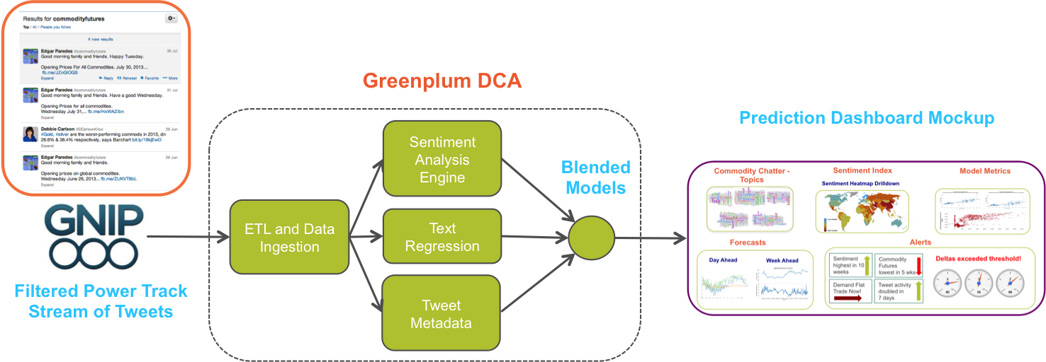
Predicting Commodity Futures through Twitter
Solution
Built Sentiment Analysis and Text Regression algorithms to predict commodity futures from Tweets
Established the foundation for blending the structured data (market fundamentals) with unstructured data (tweets)
Customer
A major a agri-business cooperative
Business Problem
Predict price of commodity futures through Twitter
Challenges
Language on Twitter does not adhere to rules of grammar and has poor structure
No domain specific label corpus of tweet sentiment – problem is semi-supervised

Slide 99
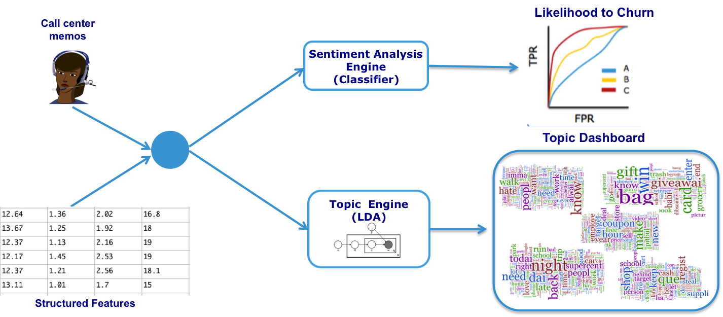
Text Analytics for Churn Prediction
Solution
Built sentiment analysis models to predict churn and topic models to understand topics of conversation in call center memos
Achieved 16% improve in ROC curve for Churn Prediction
Customer
A major telecom company
Business Problem
Reducing churn through more accurate models
Challenges
Existing models only used structured features
Call center memos had poor structure and had lots of typos

Slide 100
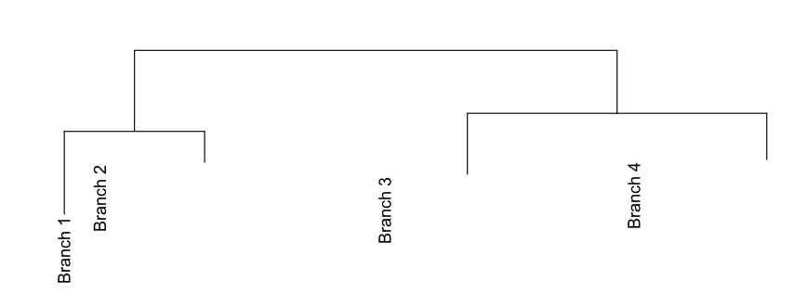
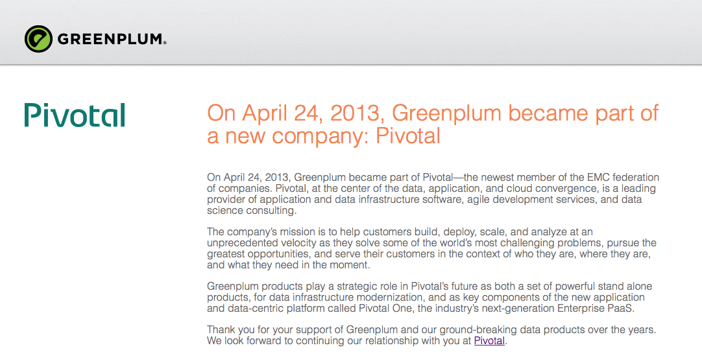

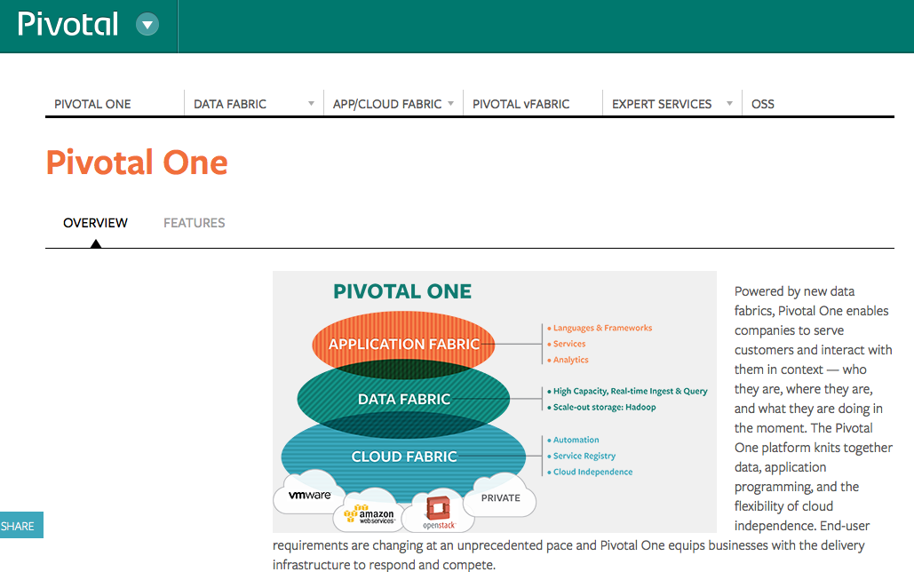

Website Classification
Solution
New hierarchical model resulted in reducing the number of previously ‘unclassified’ websites by ~75%
Created an in-database analytics framework for unsupervised learning models and enabled real-time validation of current production model
Customer
An internet domain name service provider
Business Problem
Create a multilevel website classification that groups websites by function rather than topic
Challenges
Complex unstructured data format required several transformations
Model needed to be language independent, so classic language features could not be used
Map of Domains

Slide 101
Lab: Analytics with MADlib

Slide 102
Lab: Create a complete feature vector
Now that we have the basic GPText structures in place, we need to create a training data set and a test data set. First we have to create a table to hold all the feature vectors
-- 2.0 Create Train & Test sets, to build a predictive model using SVM
drop table if exists gptextdemo.twenty_news_groups_fvect_tfidf_all cascade;
create table gptextdemo.twenty_news_groups_fvect_tfidf_all as
(select t1.doc_id as id,
madlib.svec_return_array(t1.tf_idf) as ind,random() as rand_num,
-- We will detect if a news group discussion is about computers or not
case when t2.label in ('comp.graphics','comp.os.mswindows.misc','comp.sys.ibm.pc.hardware','comp.windows.x')
then 1 else -1
end as label
from gptextdemo.twenty_news_groups_fvect_tfidf t1, gptextdemo.twenty_news_groups t2
where t1.doc_id = t2.doc_id
) distributed by (id);
\x
select * from gptextdemo.twenty_news_groups_fvect_tfidf_all limit 1;

Slide 103
Lab: Create a training data set
Now let us create the training data set
-- 2.1 Training set
-- 2445 CS related, 9530 non-CS related (Roughly 20% are CS related)
drop table if exists gptextdemo.twenty_news_groups_fvect_tfidf_train cascade;
create table gptextdemo.twenty_news_groups_fvect_tfidf_train as
(
select * from gptextdemo.twenty_news_groups_fvect_tfidf_all
where rand_num < 0.60
) distributed by (id);

Slide 104
Lab: Create a test data set
Now let us create the test data set
-- 2.2 Test set
-- 1555 CS related, 6467 non-CS related
drop table if exists gptextdemo.twenty_news_groups_fvect_tfidf_test cascade;
create table gptextdemo.twenty_news_groups_fvect_tfidf_test as
(
select * from gptextdemo.twenty_news_groups_fvect_tfidf_all
where rand_num > 0.60
) distributed by (id);

Slide 105
Lab: Now we have to actually train the model
Now train the model using MADlib’s lsvm_classification algorithm
Support Vector Machines - Classification Learning Function
-- 2.3 Linear SVM Classifier training
drop table if exists gptextdemo.svm_mdl_newsgrps cascade ;
drop table if exists gptextdemo.svm_mdl_newsgrps_param cascade ;
select madlib.lsvm_classification('gptextdemo.twenty_news_groups_fvect_tfidf_train',
'gptextdemo.svm_mdl_newsgrps',
false
);

Slide 106
Lab: Now let us do some prediction
Now let’s do some prediction using the model and MADlib’s lsvm_predict_batch algorithm
Support Vector Machines - Prediction Function
-- 2.4 Linear SVM prediction
drop table if exists gptextdemo.twenty_news_groups_svm_predictions cascade;
select madlib.lsvm_predict_batch(
'gptextdemo.twenty_news_groups_fvect_tfidf_test',
'ind',
'id',
'gptextdemo.svm_mdl_newsgrps',
'gptextdemo.twenty_news_groups_svm_predictions',
false
);

Slide 107
Lab: Now let us show the prediction accuracy
Now let’s show the accuracy of the model (should be around 82% - 85%, which is fairly decent)
-- Show SVM prediction accuracy
-- 82% accuracy
select 'svm' as model, sum(is_correct)*100.0/sum(dummy) as precision
from
( -- Verify if the predicted label is equal to the actual label
select id, case when actual_label = predicted_label then 1 else 0 end as is_correct, 1 as dummy
from
(
-- Show id, actual label & predicted label
select t1.id, t1.label as actual_label,
case when t2.prediction > 0 then 1 else -1 end as predicted_label
from gptextdemo.twenty_news_groups_fvect_tfidf_test t1, gptextdemo.twenty_news_groups_svm_predictions t2
where t1.id = t2.id
) q1
) q2;

Slide 108
Lab 5
Search Queries

Slide 109
Faceted Search Query
Faceted Field Search:
SELECT * FROM gptext.faceted_field_search(
idx_name,
search_query,
filter_queries,
facet_fields,
facet_limit,
minimum
);
idx_name, search_query and filter_queries are as same as that in search.
facet_fields - what fields faceted results are grouped by
facet_limit - the number of results to be returned
minimum - only results with count number >= minimum to be returned

Slide 110
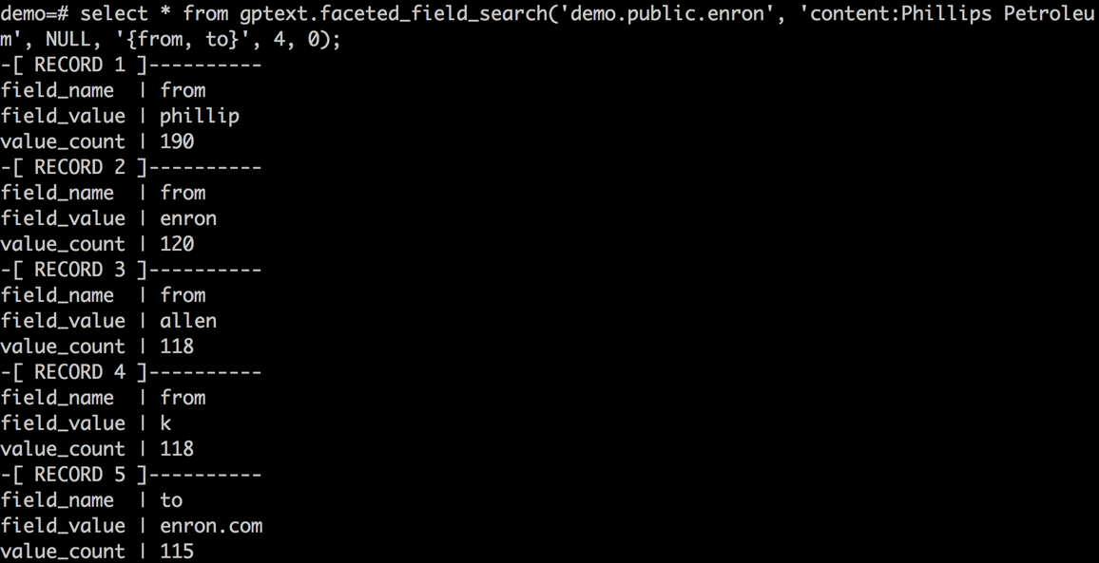
Faceted Field Search Example
Get the aggregation number of each group of field given by fields array

Slide 111
Faceted Search Query
Faceted Query Search:
SELECT * FROM gptext.faceted_query_search(
idx_name,
search_query,
filter_queries,
facet_queries
);
idx_name, search_query and filter_queries are as same as that in search.
facet_queries - what queries faceted results are grouped by

Slide 112
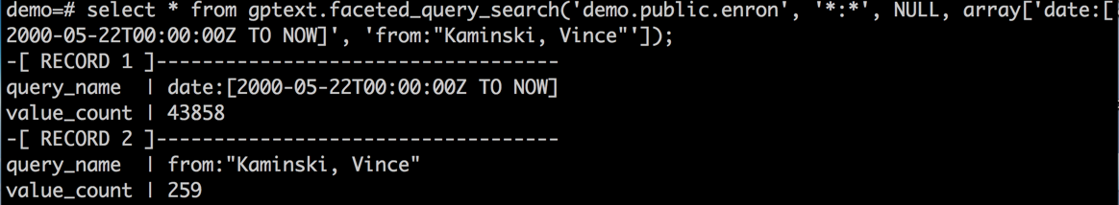
Faceted Query Search
Specify multi queries in queries array to get multi aggregation

Slide 113
Faceted Search Query
Faceted Query Search:
SELECT * FROM gptext.faceted_range_search(
idx_name,
search_query,
filter_queries,
range_start,
range_end,
range_gap
);
idx_name, search_query and filter_queries are as same as that in search.
range_start, range_end, range_gap - used to generated range intervals by which facted results are grouped

Slide 114
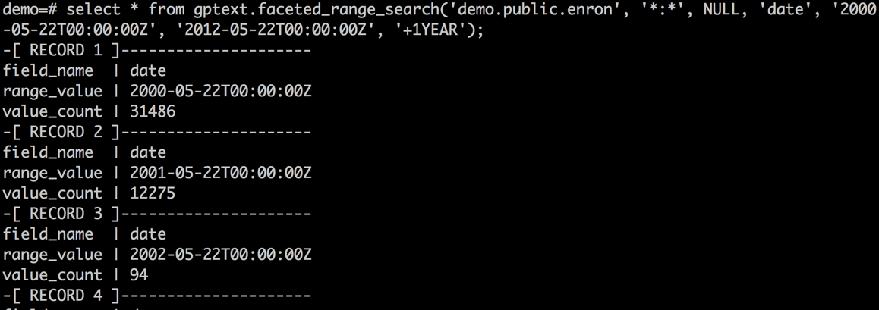
Faceted Range Search
Get the aggregation number of each group generated by start, end and gap.

Slide 115
Search Count
SELECT * FROM gptext.search_count(
TABLE( SELECT 1 SCATTER BY 1),
idx_name,
search_query,
filter_queries
);
Lightweight search query
Used when you only care about the number of documents that match
Useful to gauge approximate return set of a given query
Much faster than a search because no results are returned from the indexes

Slide 116
GPText + MADLib

Slide 117
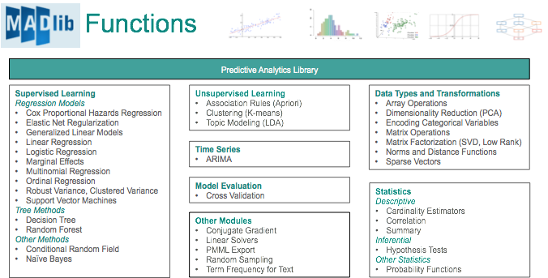
Madlib - GPDB In-database Analytics

Slide 118
Term Vectors
Populating Term Vectors in Database:
SELECT * FROM gptext.terms(
TABLE(SELECT 1 SCATTER BY 1),
idx_name,
field_name,
search_query,
filter_queries,
options
);
Extract term vectors from Solr
Terms switch on by gptext.enable_terms(idx_name, field_name) before indexing
Preserve all works done during index time analysis
Term vectors used for further in-database analysis
Term vectors can be selectively extracted by using <search_query> and <filter_queries>

Slide 119
Term Vectors
Term extract example:
Original Tweet: Finally got an iPhone 4S
select * from gptext.terms( TABLE( select 1 scatter by 1), 'demo.twitter.message', 'message_text', 'id:199206', null, null );
id | term | positions
--------+-------+-----------
199206 | 4s | {4}
199206 | final | {0}
199206 | got | {1}
199206 | iphon | {3}
(4 rows)
Term Vectors created in Solr at index time
Selectively extract the terms through the database at any point
Stop words, protected words, stemming, etc. all applied

Slide 120
Term Vectors
Creating a terms table:
CREATE TABLE myterms AS
SELECT id AS doc_id, term, positions FROM gptext.terms(
TABLE(SELECT 1 SCATTER BY 1),
<my_schema>.<my_table>,
<my_field>,
‘*:*’,
‘lang:eng’,
‘rows=50’
);

Slide 121
Term Vectors
Creating a dictionary from term vectors:
CREATE TABLE dict AS
SELECT
row_number() OVER( ORDER BY term ASC ) term_id,
term,
FROM <mySchema.terms>
WHERE term IS NOT NULL
GROUP BY term

Slide 122
Madlib K-means
Creating a tf-idf table from dict:
K-means algorithm:
SELECT madlib.gen_doc_svecs(
'tfidf', -- output table
'dict', 'term_id', 'term', -- term dictionary
'myterms', 'doc_id', 'term', 'positions' -- document terms);
SELECT madlib.kmeanspp(
'tfidf', 'sparse_vector',
<k_number>,
<madlib_distance_norm>,
<madlib_average_func>,
....);

